Slide 1


Slide 2
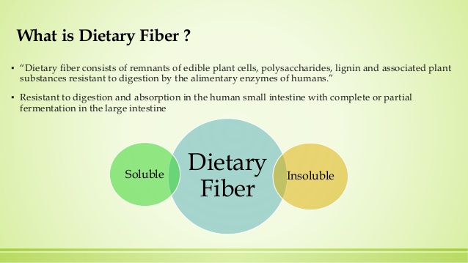

Slide 3
Fiber
Fiber is the structural part of plants and is found in vegetables, fruits, grains and legumes.
Most dietary fibers are polysaccharides, like starch, but they are not digestible.
The human body lacks the enzymes needed to digest and absorb fiber.
As a result fibers reach the lower intestine intact where intestinal bacteria can ferment some fiber.

Slide 4
Fiber
Nonstarch polysaccharide fibers
Cellulose
Hemicellulose
Pectin
Gums
Mucilages
Nonpolysaccharide fiber
Lignins
Cutins
Tannins
Resistant Starches

Slide 5
Fiber Sources
Foods are the best source of fiber, get both soluble and insoluble fiber.
Food sources of fiber include fruits, vegetables, whole grain products, legumes, nuts and seeds.
Cooking processing and removing peels can lower fiber content.

Slide 6
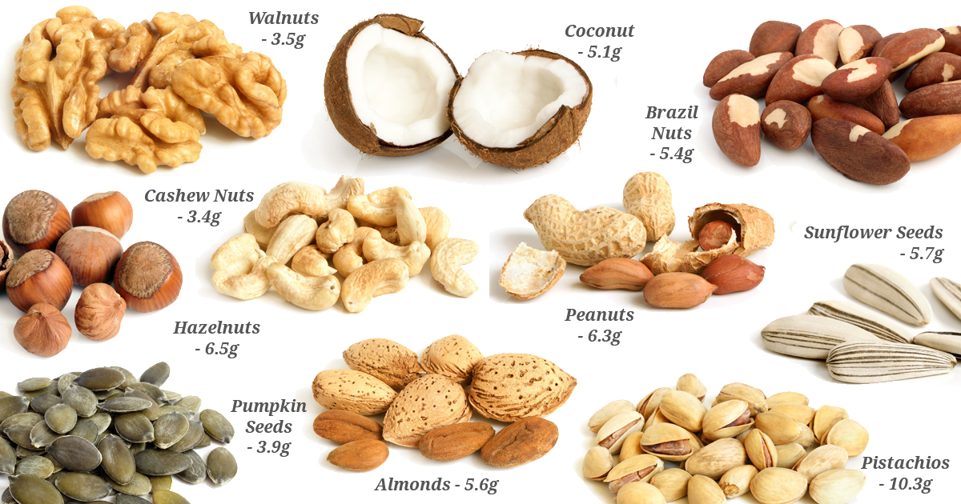
Good Sources of Dietary Fiber

Slide 7
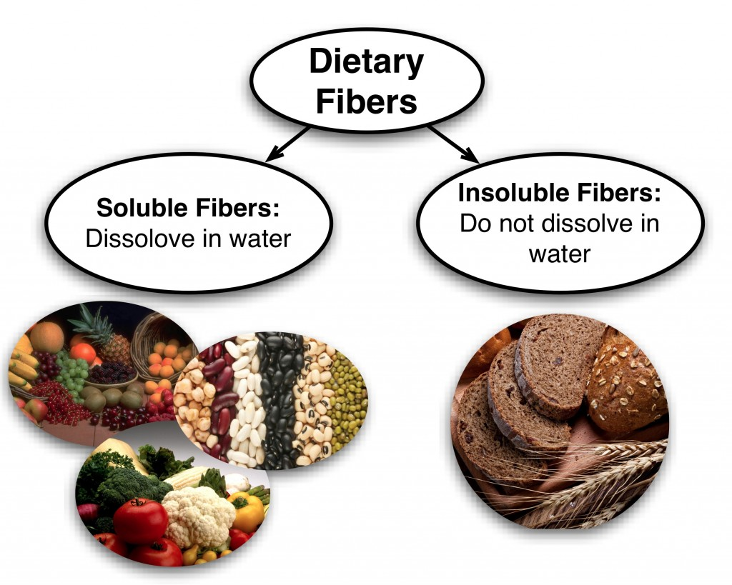

Slide 8
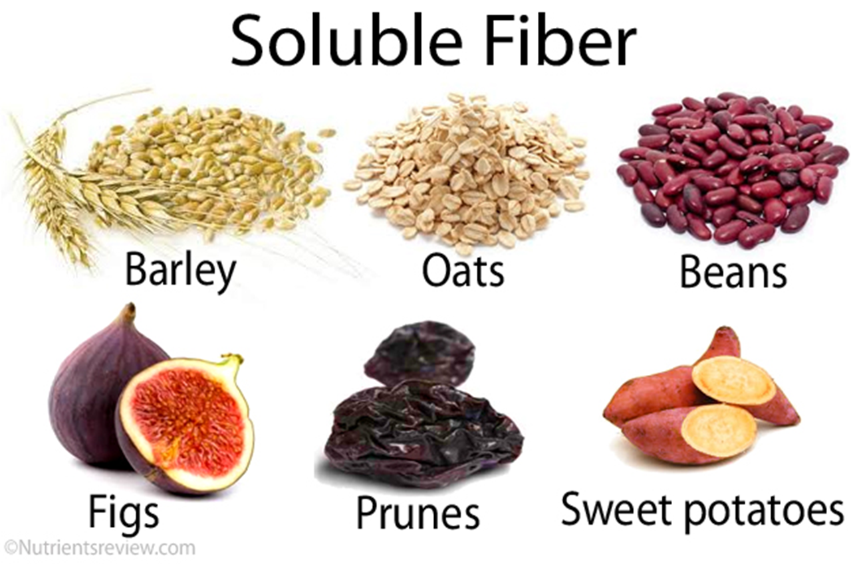

Slide 9
Soluble Fibers
Soluble fibers dissolve in water, form gels and are easily digested by bacteria in the lower intestine.
Provides a feeling of fullness.
Slow down the rate at which food leaves the stomach.
May have a role in preventing heart disease, diabetes and colon cancer
Found in legumes and fruits

Slide 10
Insoluble Fibers
Insoluble fibers absorb water and swell up resulting in a larger softer stool that is easier and quicker to pass.
Provides a feeling of fullness
Helps with intestinal function
May help with colon cancer
Found in grains and vegetables

Slide 11
Fibers and Health
Both fiber types are important for health.
Fibers are beneficial for many conditions: constipation, diarrhea, diverticular disease, heart disease, diabetes and colon cancer.
Fiber is only one factor involved in these conditions.

Slide 12
Dietary Fiber and Health
Foods having high fiber have many factors that may be playing a role in lowering disease risk.
High fiber
Low in fat
High vitamins (antioxidants)
High in minerals
High in phytochemicals

Slide 13
Intestinal Function
Insoluble fibers absorb water resulting in a larger, softer stool that is faster and easier to eliminate, which can help with:
Constipation
Hemorrhoids
Diverticular disease

Slide 14
Colon Cancer
Both insoluble and soluble fibers may protect against colon cancer
Insoluble fibers absorb water making a larger, softer stool which can:
Dilute potential carcinogens
Reduce transit time so the colon is exposed to any cancer causing substance for less time.
Soluble fibers can bind bile acids, potential carcinogens, and increase their excretion.

Slide 15
Heart Disease
As mentioned, soluble fibers can bind to bile acids and increase their excretion.
With fewer bile acids in the intestine, less fat is absorbed.
Also by increasing bile acid excretion, the liver must use its cholesterol to make new bile acids.

Slide 16
Diabetes
Soluble fibers may have a favorable effect on blood glucose.
Soluble fibers decrease the rate at which food is released from the stomach and delays glucose absorption into the blood.
This may help prevent wide swings in blood glucose throughout the day.

Slide 17
Weight Management
Foods rich in complex carbohydrates tend to be low in fat and added sugars which can help with weight management by providing fewer calories.
In addition, as fibers absorb water they swell up creating a feeling of fullness and delaying hunger.

Slide 18
Fiber Intake
The National Research Council set a Dietary Reference Intake (DRI) for dietary fiber.
An adequate Intake (AI) for dietary fiber was set at 14 grams dietary fiber per 1,000 calories.
Thus for a reference 2,000 calorie diet recommended intake would be 28 grams per day.

Slide 19
Tips for Increasing Fiber intake
Increase fiber slowly. Increasing fiber too fast may cause bloating and gas.
Since some fiber absorbs water, so it also is important to drink plenty of fluids when increasing dietary fiber.
As with all nutrients, “more” is not “better.” Moderation is the key.

Slide 20
Too much Fiber intake
Dietary fiber can bind some minerals and decrease their absorption. However, if mineral intake is adequate a recommended dietary fiber intake will not compromise mineral balance.
Fiber intake is like all nutrients - “more” is not always “better.” Consuming a diet that provides a variety of nutrients is the key.

